Slide 1

COMPILER DESIGN
Unit 5: Code Generation
Prakash C O
Department of Computer Science and Engineering

Slide 2

COMPILER DESIGN
Unit 5: Code Generation Introduction
Prakash C O
Department of Computer Science and Engineering

Slide 3
COMPILER DESIGN
Unit 5: Code Generation
Introduction
The final phase in our compiler model is the code generator.
Code generator takes as input the intermediate representation(IR) produced by the front end of the compiler, along with relevant symbol table information, and produces as output a semantically equivalent target program, as shown in Figure.
Source Program
Front End
Intermediate
code
Code
Optimizer
Intermediate code
Code
Generator
Target Program

Slide 4
COMPILER DESIGN
Unit 5: Code Generation
Introduction
Linear representations - 3AC/SSA (Quadruples / Triples / Indirect triples)
VM instructions (Bytecodes / Stack machine codes)
Graphical representations (Syntax trees / DAGs)
Intermediate Representation
Code Generator
RISC (many registers, 3AC, simple addressing modes, simple ISA)
CISC (few registers, 2AC, variety of addressing modes, several register classes,
variable length instructions, instructions with side-effects)
Stack machine (push/pop, stack top uses registers, used in JVM, JIT compilation)
Target Machine Code
*

Slide 5
COMPILER DESIGN
Unit 5: Code Generation
Introduction
t0 = y
t0 = t0 + z x = t0
Intermediate Representation
Code Generator
LD R0, y
ADD R0, R0, z ST x, R0
Target Machine Code

Slide 6
COMPILER DESIGN
Unit 5: Code Generation
Introduction
The requirements imposed on a code generator are severe.
The target program must preserve the semantic meaning of the
source program.
Meaning intended by the programmer in the original source program should carry forward in each compilation stage until code-generation.
The target program must be of high quality.
Execution time or space or energy or …
The code generator itself must run efficiently.
Instruction Selection, Register Allocation and Instruction ordering.
*

Slide 7
COMPILER DESIGN
Unit 5: Code Generation
Introduction
The challenges in code generation are,
Mathematically, the problem of generating an optimal target program for a given source program is undecidable;
Many of the subproblems encountered in code generation such
as register allocation are Computationally intractable(NP-Hard).
*

Slide 8
COMPILER DESIGN
Unit 5: Code Generation
Introduction
A code generator has three primary tasks:
Instruction Selection
o It involves choosing appropriate target-machine instructions to implement the IR statements.
IR Code: t0 = y
t0 = t0 + z x = t0
Register Allocation & Assignment
It involves deciding what values to keep in which registers.
Instruction ordering
It involves deciding in what order to schedule the execution of instructions
Target Code: LD R0, y
ADD R0, R0, z
ST x, R0

Slide 9
COMPILER DESIGN
Unit 5: Code Generation
Issues in the Design of a Code Generator
Prakash C O
Department of Computer Science and Engineering

Slide 10
COMPILER DESIGN
Unit 5: Code Generation
Issues in the Design of a Code Generator
The code generator design issues details are dependent on
the specifics of Intermediate Representation,
the Target Language, and the Run-time system,
tasks such as Instruction Selection, Register Allocation and Assignment,
and Instruction Ordering.
The most important criterion for a code generator is that it produce
correct target code.
*

Slide 11
COMPILER DESIGN
Unit 5: Code Generation
Issues in the Design of a Code Generator Issues in the Design of a Code Generator are:
Input to the Code Generator
The Target Program
Instruction Selection
Register Allocation
Evaluation Order

Slide 12
COMPILER DESIGN
Unit 5: Code Generation
1. Input to the Code Generator
The input to the code generator is
The intermediate representation(IR) of the source program produced by the front end, and
Information in the symbol table that is used to determine the run-
time addresses of the data objects denoted by the names in the IR.

Slide 13
COMPILER DESIGN
Unit 5: Code Generation
1. Input to the Code Generator
The many choices for the intermediate representation(IR) include
Three-address representations such as
Quadruples, Triples, and Indirect triples
Virtual machine representations such as
Bytecodes and stack-machine code
Linear representations such as
Postfix notation
Graphical representations such as
Syntax trees and DAG's.

Slide 14
COMPILER DESIGN
Unit 5: Code Generation
1. Input to the Code Generator
Assumptions:
The front end has scanned, parsed, and translated the source program into a relatively low-level Intermediate Representation.
All syntactic and static semantic errors have been detected properly.
The necessary type checking has taken place, and that type conversion operators
have been inserted wherever necessary.
The code generator can therefore proceed on the assumption that its input is free of
these kinds of errors.
*

Slide 15
COMPILER DESIGN
Unit 5: Code Generation
2. The Target Program
The instruction-set architecture of the target machine has a significant impact on the difficulty of constructing a good code generator that produces high-quality machine code.
The most common target-machine architectures are
RISC (Reduced Instruction Set Computer),
CISC (Complex Instruction Set Computer), and
Stack based Architecture.

Slide 16
COMPILER DESIGN
Unit 5: Code Generation
2. The Target Program
A RISC machine typically has
many registers,
three-address instructions,
simple addressing modes, and
a relatively simple instruction-set architecture.
A CISC machine typically has
few registers,
two-address instructions,
a variety of addressing modes,
several register classes,
variable-length instructions.
Examples of RISC microprocessors are Alpha,
ARC, ARM, AVR, MIPS, PA-RISC, PIC, Power
Architecture, and SPARC
Examples of CISC processors are the System/360, VAX, PDP-11, Motorola 68000 family, AMD and Intel x86 CPUs.
*

Slide 17
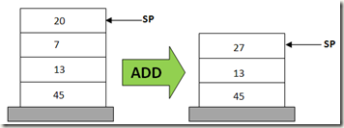
COMPILER DESIGN
Unit 5: Code Generation
2. The Target Program
Stack based Architecture
Stack-based architectures were revived with the introduction of the JVM.
Example: In a stack based virtual machine, the operation of adding two numbers would usually be carried out in the following manner (where 20, 7, and ‘result’ are the operands):
POP 20
POP 7
ADD 20, 7, result
PUSH result
*

Slide 18
COMPILER DESIGN
Unit 5: Code Generation
2. The Target Program
The target program is the output of the code generator.
The output may be absolute machine language code, relocatable machine language code or assembly language code
Producing an absolute machine-language program as output has the advantage that it
can be placed in a fixed location in memory and immediately executed.
Producing a relocatable machine-language program (often called an object module) as output allows subprograms to be compiled separately.
A set of relocatable object modules can be linked together and loaded for execution by a
linking loader.
*

Slide 19
COMPILER DESIGN
Unit 5: Code Generation
2. The Target Program
The target program is the output of the code generator. The output may be absolute machine language code, relocatable machine language code or assembly language code
Producing an assembly-language program as output makes the process of code
generation somewhat easier.
We can generate symbolic instructions and use the macro facilities of the assembler to help generate code.
The price paid is the assembly step after code generation.

Slide 20
COMPILER DESIGN
Unit 5: Code Generation
2. The Target Program
For readability, we use assembly code as the target language.
As long as addresses can be calculated from offsets and other information stored in the symbol table, the code generator can produce relocatable or absolute addresses for names just as easily as symbolic addresses.

Slide 21

COMPILER DESIGN
Unit 5: Code Generation
3. Instruction Selection
The code generator must map the IR program into a code sequence that can be executed by the target machine.
The complexity of Instruction Selection depends upon
Level of the IR
Nature of the Instruction-Set Architecture(ISA)
Desired quality of the generated code.

Slide 22
COMPILER DESIGN
Unit 5: Code Generation
3. Instruction Selection
The complexity of Instruction Selection depends upon
Level of the IR
If the IR is high level, the code generator may translate each IR statement into a
sequence of machine instructions using code templates.
Such statement-by-statement code generation, however, often produces poor code that needs further optimization.
If the IR reflects some of the low-level details of the underlying machine, then the
code generator can use this information to generate more efficient code sequences.
o e.g., intsize versus 4.

Slide 23
COMPILER DESIGN
Unit 5: Code Generation
3. Instruction Selection
The complexity of Instruction Selection depends upon
Nature of the Instruction-Set Architecture(ISA)
The nature of the instruction set of the target machine has a strong effect on the
difficulty of instruction selection.
For example, the uniformity and completeness of the instruction set are important factors.
If the target machine does not support each data type in a uniform manner, then each
exception to the general rule requires special handling.
On some machines, for example, floating-point operations are done using separate
registers.

Slide 24
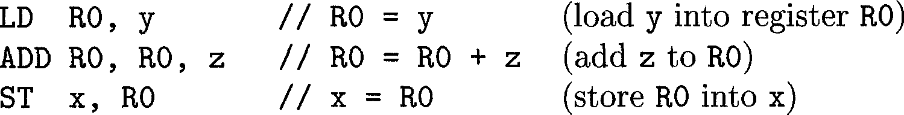
COMPILER DESIGN
Unit 5: Code Generation
3. Instruction Selection
The complexity of Instruction Selection depends upon
Desired quality of the generated code.
If we do not care about the efficiency of the target program, instruction selection is straightforward.
For each type of three-address statement, we can design a code skeleton that defines the target code to be generated for that construct.
For example, every three-address statement of the form x = y + z, where x, y, and z are
statically allocated, can be translated into the code sequence

Slide 25
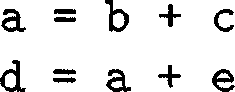
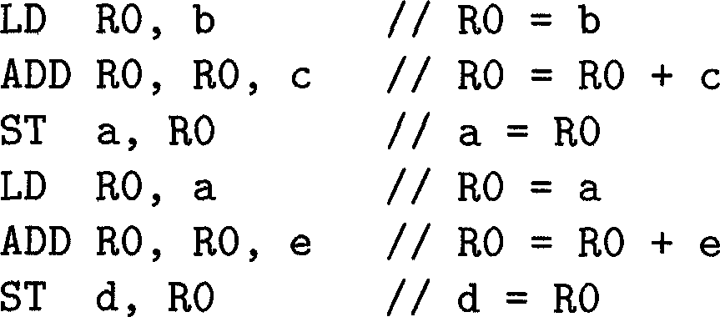
COMPILER DESIGN
Unit 5: Code Generation
3. Instruction Selection
If we do not care about the efficiency of the target program, instruction selection is straightforward.
This strategy often produces redundant loads and stores. For example, the sequence of three-address statements
would be translated into
a = b + c
d = a + e
Here, the fourth statement is redundant since it loads a value that has just been stored, and so is the third if a is not subsequently used.

Slide 26
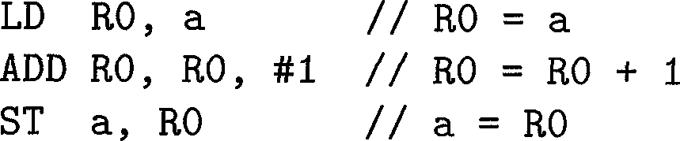
COMPILER DESIGN
Unit 5: Code Generation
3. Instruction Selection
The quality of the generated target code is usually determined by its speed and size.
A given IR program can be implemented by many different code sequences, with significant cost differences between the different implementations.
A naive translation of the intermediate code may therefore lead to correct but unacceptably inefficient target code.
For example, if the target machine has an INC instruction, then a = a + 1 may be implemented more efficiently by the single instruction INC a, rather than

Slide 27
COMPILER DESIGN
Unit 5: Code Generation
4. Register Allocation
A key problem in code generation is deciding what values to hold in what registers.
Registers are the fastest computational unit on the target machine, but we usually do not have enough of them to hold all values.
Values not held in registers need to reside in memory.
Instructions involving register operands are invariably shorter and faster than those involving operands in memory, so efficient utilization of registers is particularly important.
Keep values in registers as long as possible to minimize the number of load / store statements executed.

Slide 28
COMPILER DESIGN
Unit 5: Code Generation
4. Register Allocation
The use of registers is often subdivided into two subproblems:
Register allocation, during which we select the set of variables that will reside in registers at each point in the program.
Register assignment, during which we pick the specific register that a variable will reside in.
Register allocation - deciding which values to keep in registers. Register assignment - choosing specific registers for values.
Finding an optimal assignment of registers to variables is difficult, even with
single-register machines. Mathematically, the problem is NP-complete.

Slide 29
COMPILER DESIGN
Unit 5: Code Generation
4. Register Allocation
The register allocation problem is further complicated because the hardware and/or the operating system of the target machine may require that certain register-usage conventions be observed.
Example 8.1 : Certain machines require register-pairs (an even and next odd numbered
register) for some operands and results.
For example, on some machines, integer multiplication and integer division involve register
pairs.
The multiplication instruction is of the form
M x, y
where x, the multiplicand, is the even register of an even/odd register pair and y, the
multiplier, is the odd register. The product occupies the entire even/odd register pair.

Slide 30

COMPILER DESIGN
Unit 5: Code Generation
4. Register Allocation
Example 8.1 : cont…
The division instruction is of the form
where the dividend occupies an even/odd register pair whose even register is x; the divisor is y. After division, the even register holds the remainder and the odd register the quotient.

Slide 31
COMPILER DESIGN
Unit 5: Code Generation
5. Evaluation Order
The order in which computations are performed can affect the efficiency of the
target code.
Some computation orders require fewer registers to hold intermediate
results than others.
Picking a best computation order in the general case is a difficult NP- complete problem.
Initially, we shall avoid the problem by generating code for the TAC in the order in which they have been produced by the intermediate code generator.

Slide 32
COMPILER DESIGN
Unit 5: Code Generation
Target Machine Model (Hypothetical Model)
Prakash C O
Department of Computer Science and Engineering

Slide 33
COMPILER DESIGN
Unit 5: Code Generation
Target Machine Model
Our target computer models a three-address machine with
Load and Store operations,
Computation operations,
Jump operations, and
Conditional jumps.
The underlying computer is a byte-addressable machine with n general- purpose registers, R0, R1, . . . , R_{n - 1}.
To avoid hiding the concepts in a myriad of details, we shall use a very limited
set of instructions and assume that all operands are integers.
Most instructions consists of an operator, followed by a target, followed by a list of source operands. Ex: op dest, src1, src2

Slide 34
COMPILER DESIGN
Unit 5: Code Generation
Target Machine Model
We assume the following kinds of instructions are available:
Load (from memory) (LD Dest(Reg), Src(memloc))
Store (to memory) (ST Dest(memloc), Src(Reg))
Move (b/w registers) (MOV R1, R2)
Computations (op, dest, src1, src2)
ADD
SUB
MUL
DIV

Slide 35
COMPILER DESIGN
Unit 5: Code Generation
Target Machine Model
5. Unconditional jumps
(BR L)
(Bcond R, L)
6. Conditional jumps
cond : LTZ, GTZ, EZ, LTEZ, GTEZ
For example, BLTZ R, L causes a jump to label L if the value in register R is less than zero, and allows control to pass to the next machine instruction if not.

Slide 36
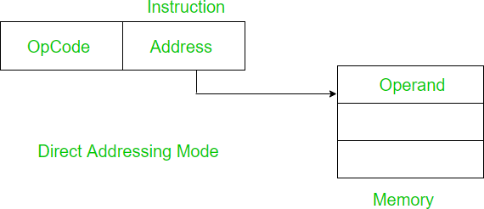
COMPILER DESIGN
Unit 5: Code Generation
Target Machine Model
Addressing Modes
Direct Addressing mode:
In direct addressing mode, the address field contains the address of the operand.
Example: Add the content of R1 and the content of 1001(memory
address) and store the result back to R1
ADD R1, (1001) Here 1001 is the address where operand is stored.
Example(Hypothetical model): ADD R1, a
Note: In our hypothetical model, for simplicity, instead of memory address of a variable,
we are using variable name in the instruction itself.

Slide 37
COMPILER DESIGN
Unit 5: Code Generation
Target Machine Model Addressing Modes
2. Index addressing mode: Index addressing mode is used to access an
array whose elements are in successive memory locations.
Example: x = a[i]
op | dest | src1 | src2
LD | R1 | i
MUL | R1 | R1 | #4
MOV | R2 | R1(a)
ST | x | R2
t1 = 4 * i t2 = a[t1] x = t2
r-value
In the above MOV instruction
R2 ← contents (contents of R1 + a ) R2 ← contents (offset + base address)

Slide 38
COMPILER DESIGN
Unit 5: Code Generation
Target Machine Model Addressing Modes
3. Indirect addressing mode:
Here two references are required. First reference to get effective address. Second reference to access the data.
Example : x = *p
op | dest | src1 | src2
LD | R1 | p
MOV | R2 | 0(R1)
ST | x | R2
t1 = *p x = t1
r-value
In the above MOV instruction: R2 ← contents(0 + contents of R1),
that is, loading into R2 the value in the memory location obtained by adding 0 to the
contents of register R1.

Slide 39
COMPILER DESIGN
Unit 5: Code Generation
Target Machine Model Addressing Modes
4. Immediate addressing mode: In this mode data is present in address field of instruction.
Example: a = 100
a = 100
op | dest | src1 | src2
LD | R1 | #100
ST | a | R1
Note: Limitation in the immediate mode is that the range of constants are restricted by size of address field.

Slide 40
COMPILER DESIGN
Unit 5: Code Generation
Target Machine Model
Note:
Byte-addressable machine.
N general purpose registers are available:
R0, R1, R2…………….. Rn
Assume all operands are integers.
Comments are preceded by //

Slide 41
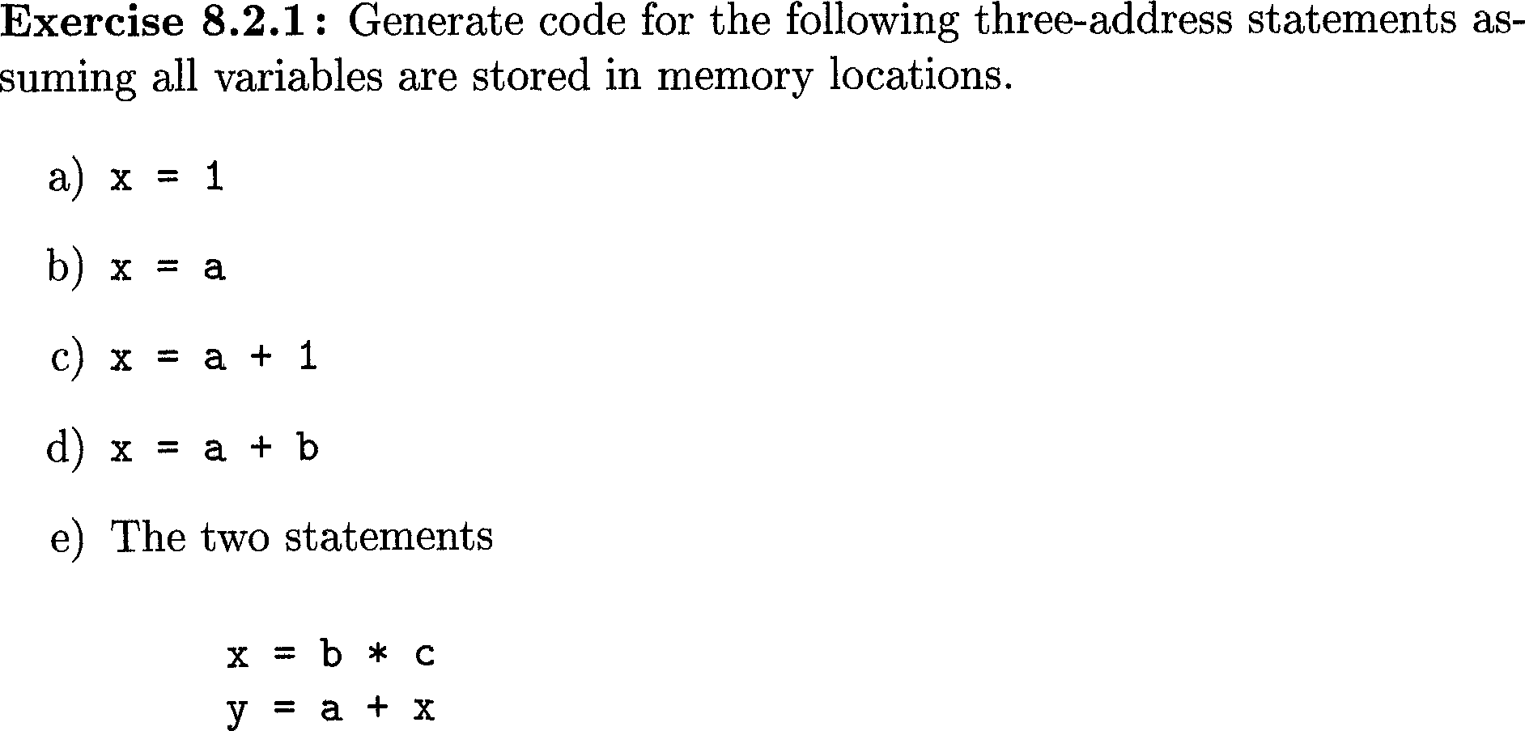
COMPILER DESIGN
Unit 5: Code Generation
Target Machine Model

Slide 42
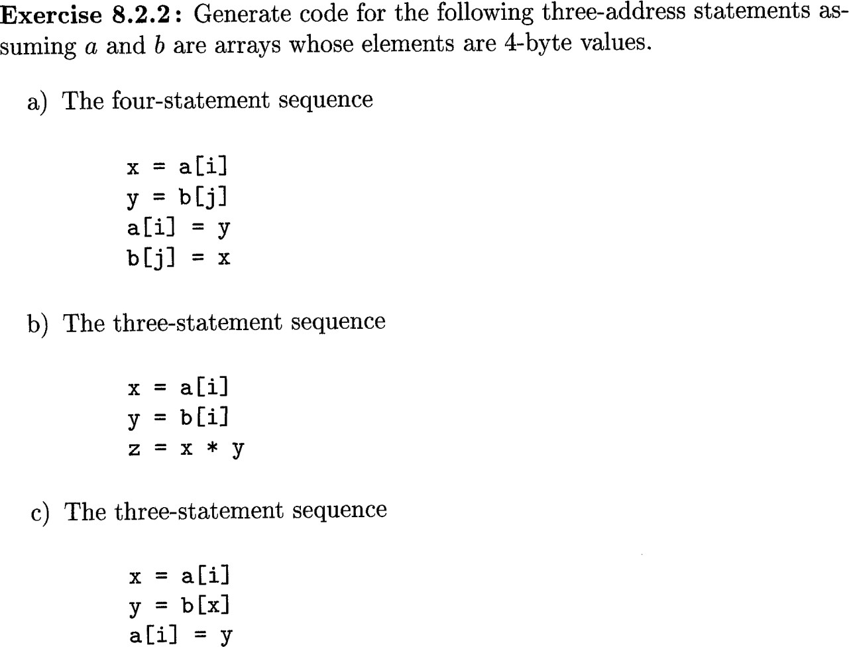
COMPILER DESIGN
Unit 5: Code Generation
Target Machine Model

Slide 43

COMPILER DESIGN
Unit 5: Code Generation
Generate Three address code and Target code for
1) a[i] = c x=a[i]
t1 = 4 * i a[t1] = c
op | dest | src1 | src2
LD | R1 | i
MUL | R1 | R1 | #4
LD | R2 | c
ST | R1(a) | R2
l-value
op | dest | src1 | src2
LD | R1 | i
MUL | R1 | R1 | #4
MOV | R2 | R1(a)
ST | x | R2
Contents of (R1 + a ) ← R2

Slide 44
COMPILER DESIGN
Unit 5: Code Generation
Generate Target code for
2) if x < y goto L
op | dest | src1 | src2
LD | R1 | x
LD | R2 | y
SUB | R1 | R1 | R2
BLTZ | R1 | M
M is the equivalent machine instruction generated for label L

Slide 45
COMPILER DESIGN
Unit 5: Code Generation
Generate Target code for
4) F = 1;
while(N > 0)
{
 | op | dest | src1 | src2
 | LD | R1 | #1
 | LD | R2 | N
L1: | BLTEZ | R2 | L2
 | MUL | R1 | R1 | R2
 | SUB | R2 | R2 | #1
 | BR | L1
L2: | ST | F | R1
 | ST | N | R2
R1 ← F
F | = F | * N;
N | = N | – 1;
}
R2 ← N
TAC:
F=1
L1 : if(N <= 0) goto L2 F = F * N
N = N - 1
goto L1
L2 :

Slide 46
COMPILER DESIGN
Unit 5: Code Generation
Generate Target code for
 | op | dest | src1 | src2
 | LD | R1 | #0
 | MOV | R2 | R1
 | LD | R3 | n
L1: | SUB | R4 | R3 | R1
 | BEZ | R4 | L2
 | ADD | R2 | R2 | R1
 | ADD | R1 | R1 | #1
 | BR | L1
L2: | ST | i | R1
 | ST | s | R2
3) i = 0
s = 0
L1: if i >= n goto L2 s = s + i
i = i + 1 goto L1
R1 ← i
R2 ← s
R3 ← n
L2:

Slide 47
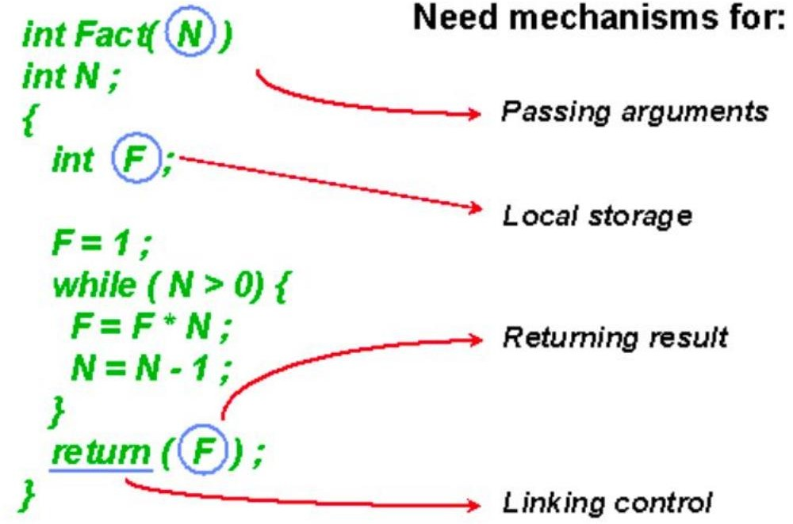
COMPILER DESIGN
Unit 5: Code Generation
How do we generate Target code when procedures are involved?

Slide 48
COMPILER DESIGN
Unit 5: Code Generation
How do we generate Target code when procedures are involved?
Many questions to answer:
What does the dynamic execution of functions look like?
Where is the executable code for functions located?
How are parameters passed in and out of functions?
Where are local variables stored?

Slide 49
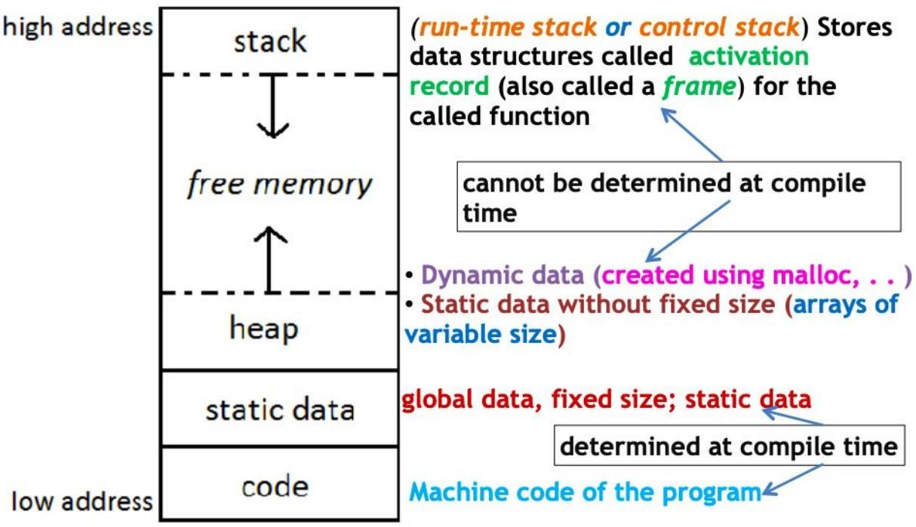

COMPILER DESIGN
Unit 5: Code Generation
Memory Layout of an executable program

Slide 50
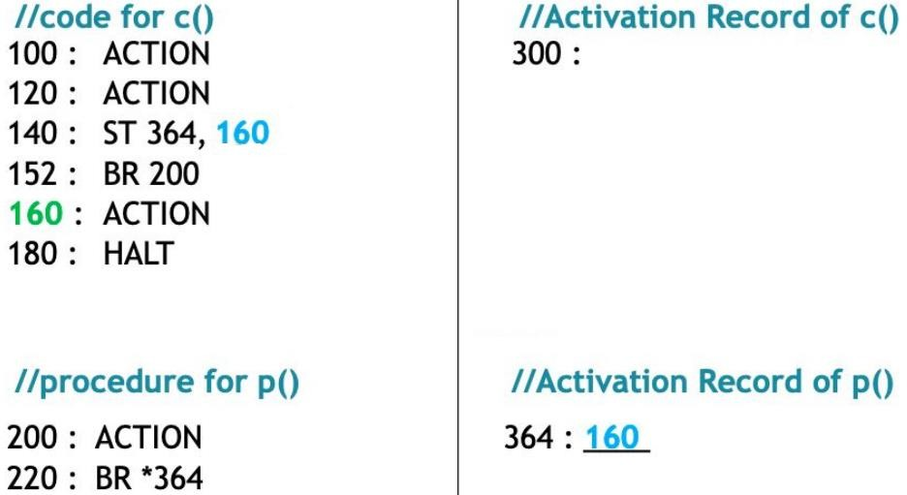
COMPILER DESIGN
Unit 5: Code Generation
Code generation for procedures (Static allocation)
IC for | Procedure | C()
action action call p action halt
IC for | Procedure | p()
action return
Note: action denotes set of three-address statements, target code of action (i.e., ACTION) takes 20 bytes memory.

Slide 51
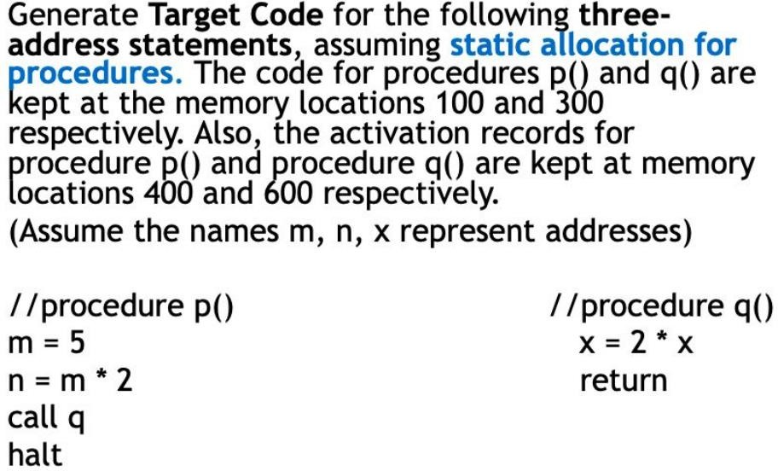
COMPILER DESIGN
Unit 5: Code Generation
Code generation for procedures (Static allocation)

Slide 52
COMPILER DESIGN
Unit 5: Code Generation
Code generation for procedures (Static allocation)
IC for Procedure p()
m=5 n=m*2 call q halt
Target code for p()
Activation record of p()
400: …
Activation record of q() 600: 152
100: LD
108: ST
R1, #5 m, R1
116: MUL R1, R1, #2
124: ST n, R1
132: ST 600, 152
144: BR 300
152: HALT
IC for Procedure q()
x=2*x
return
Target code for q() 300: LD R1, x
308: MUL R1,R1,#2
316: BR *600

Slide 53
COMPILER DESIGN
References
Compilers–Principles, Techniques and Tools, Alfred V. Aho, Monica S. Lam, Ravi Sethi, Jeffery D. Ullman, 2nd Edition
https://markfaction.wordpress.com/2012/07/15/stack-based-vs-register- based-virtual-machine-architecture-and-the-dalvik-vm/

Slide 54
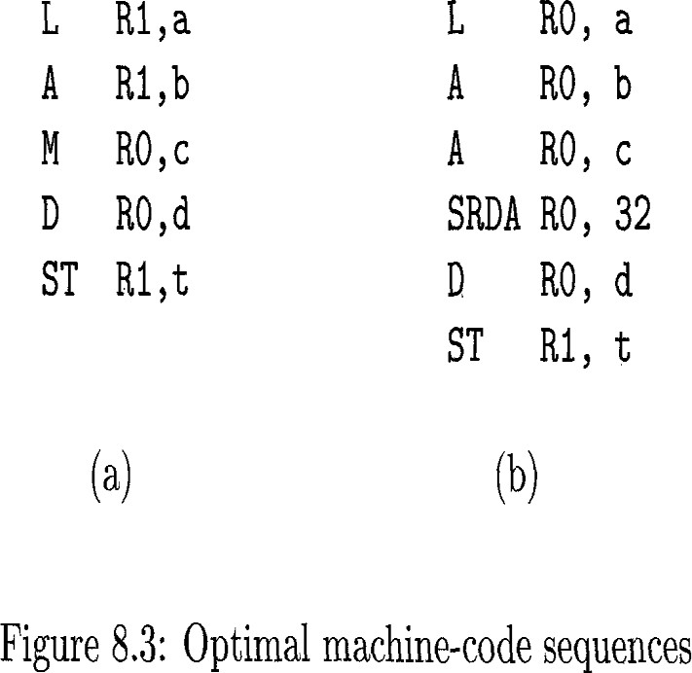
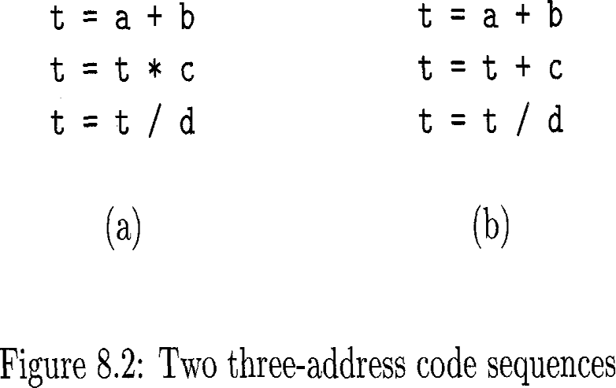
COMPILER DESIGN
Unit 5: Code Generation
4. Register Allocation
Consider the two three-address code sequences in Fig. 8.2 in which the only difference in (a) and (b) is the operator in the second statement. The shortest assembly-code sequences for (a) and (b) are given in Fig. 8.3.
Ri stands for register i. SRDA stands for Shift-Right-Double-Arithmetic and
SRDA R0,32 shifts the dividend into R1 and clears R0 so all bits equal its sign bit.

Slide 55
THANK YOU
Prakash C O
Department of Computer Science and Engineering
coprakasha@pes.edu
+91 98 8059 1946

